Slide 1


Kippot Mitzvah Project
Supporting the Hadassah primary school and the Abayudaya jewish Community of Uganda

Slide 2
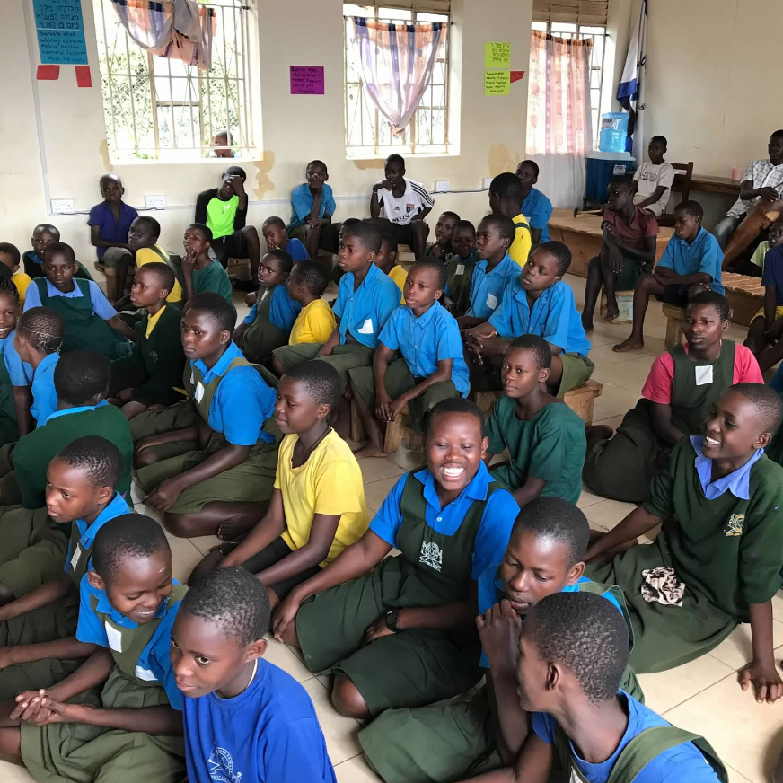
Who are the Abayudaya and How Can My Student Help?
The Abayudaya are the Jewish community of east Africa, centered around Mbale, Uganda and stretching into neighboring Kenya. The community adopted Judaism in 1919 and currently numbers over 2,000 Jews. The community is strong, but its members have significant food, medical, and economic insecurities that are common to East Africa.
The Abayudaya have a synagogue in each of their villages, including the primary synagogue on Nabagoya Hill. The community is led by Rabbi Gershom Sizomu, the first African-born Jew to be ordained by the Zeigler School in Los Angeles. The community was officially welcomed into the worldwide Jewish community when they were converted by a delegation of Masorti-Conservative rabbis from North America in 2009.
The Abayudaya operate two schools that educate local children of all faiths. The Hadassah Primary School educates most young Abayudaya children and many non-Jewish students from the neighborhood. Even with all its success, the school requires significant continued investment from throughout the Jewish world.
Your child/student’s efforts on behalf of the Abayudaya will empower them as they enter adulthood. The project will give them ownership of their Jewish journey through raising awareness of the Abayudaya and through their support of global Jewry.
Music class at the Hadassah Primary School. The school consistently performs well at national choral competitions

Slide 3
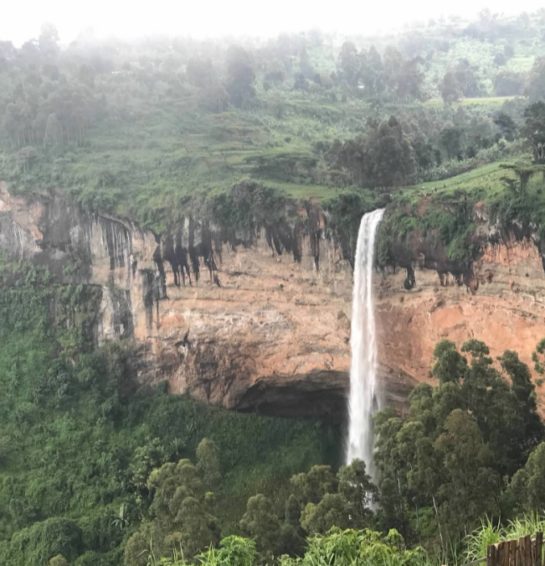
How Can Your B’nai Mitzvah Student Help?
This project came to life when a student from a Philadelphia suburban synagogue decided to think outside the box to make a huge impact for the Abayudaya Jewish community. The student raised thousands of dollars for the Hadassah Primary School by following these steps:
  Order yarmulkes for your mitzvah attendees through the Abayudaya Men’s Club. This Club is an affiliate of the Federation of Jewish Men’s Clubs. Each yarmulke will cost approximately $5 USD. They will be handsewn within the community and sent to your home via DHL or UPS. The Jewish artists making your beautiful kippot are fairly compensated for their efforts. You can choose color and design to fit your child’s them for the day.
  Purchase stickers to identify the yarmulkes as from your child’s b’nai mitzvah as made by the Abayudaya Jewish community of Uganda. Our pilot project student found a great seller of these stickers on Etsy.
  Through social media posts and direct solicitations, educate your friends, family and synagogue community about the Abayudaya, and appeal to them to donate money through a Go-Fund-Me campaign.
Sipi Falls at the nearby Mt Elgon National Park

Slide 4
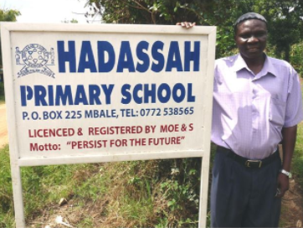
How Can Your B’nai Mitzvah Student
Help (continued)?
  Your student should introduce the Abayudaya to your synagogue community in their b’nai mitzvah d’var torah and work with your rabbis and religious school director to teach the children about this fascinating community in Uganda.
  Once your funds have been collected, send them to the following FJMC donation page: http://abayudaya.seaboardfjmc.us/ (Donating through the FJMC page will allow you to apply for matching contributions from your employer, if offered).
  The FJMC will distribute the funds on your behalf to the school in support of the children. Funds are used to purchase solar panels, books, computers, and scholarships. The school will send your child a video message to thank them for the support and hard work.
Aaron Kintu Moses z”l, the founder and first director of the Hadassah Primary School

Slide 5
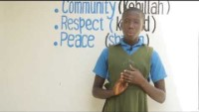
Meet Dinnah
Dinnah is a young student at the Hadassah Primary School. Dinnah studies hard to build a future for herself while also contributing to the chores necessary to support her family. These chores include gathering and cutting firewood, retrieving water from wells, and caring for young and ailing family members. Dinnah is a true inspiration, and her story is indicative of the experiences all Abayudaya children.
https://youtu.be/qiJhIHLkZL8

Slide 6
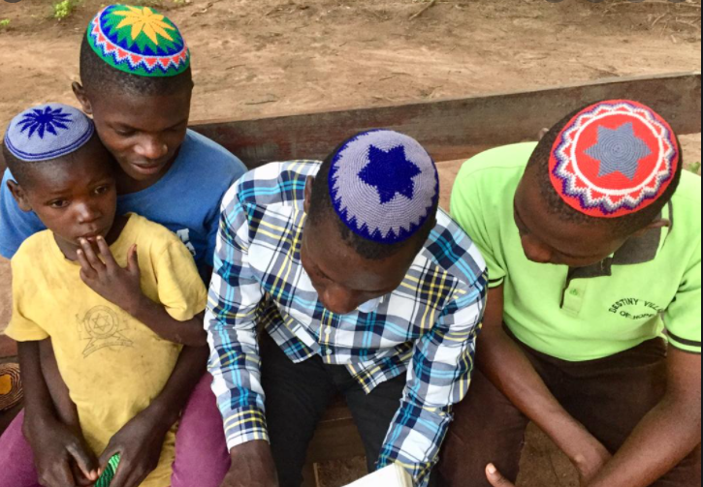
How Can We Learn More about the Abayudaya?
  Snapshot of the Abayudaya (video)
  Story of the Abayudaya Conversion (video)
  FJMC Convention Presentation (video)
  History of the Abayudaya

Slide 7
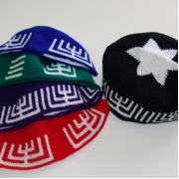
How can your student get started on this project?
  Contact Alan Zilaba, Men’s Club leader in Mbale, Uganda – allanzilaba@gmail.com to purchase your kippot. If, by the time you implement this plan, Alan is no longer the Men’s Club president, he will forward your communication to the appropriate new leader. Allan will help you pick out colors and design for your kippot. *Please allow 2-3 months for sewing and shipping.
  Payments can be sent directly to the Men’s Club using the Sendwave app (available in the AppStore), or the FJMC can help facilitate the transfer of funds.
  Research the Abayudaya with your student so that they can appreciate the impact this project will have on an entire community of Jews.
  Contact FJMC Abayudaya Liaison, David Freiman, with questions or concerns – davidafreiman@gmail.com

Slide 8


