Slide 1
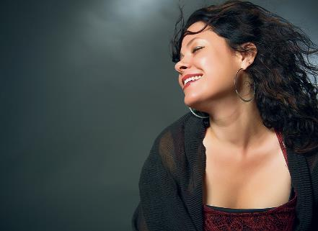
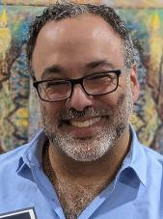
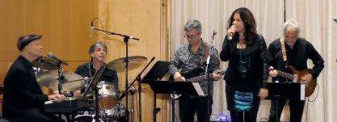
The Brotherhood of Temple Israel of Sharon presents
About Neshama
Neshama Carlebach is an award-winning singer, songwriter and educator who has performed and taught in cities around the world. A winner and four-time nominee in the Independent Music Awards for her most current release, Believe, and winner of the Global Music Awards Silver Award for Outstanding Performance by a female vocalist for the album, Neshama has sold over one million records, making her one of today’s best-selling Jewish artists in the world. Neshama has been a cornerstone of major Jewish music festivals across the U.S. and globally, performing in front of thousands at countless concerts and gatherings for audiences of all ages and backgrounds in. As a teenager she performed alongside her father, the late Rabbi Shlomo Carlebach. As the first then-Orthodox woman of her generation to perform for a mixed-gender audience, Neshama has sparked public conversations with brave forays into the place of women in Judaism and today’s world. During the worldwide pandemic, Neshama was able to pivot and transform her work platform. From her home studio, Neshama performed and participated in over 350 Zoom events, ranging from fundraisers to gala events and life cycle moments where she was able to provide solace, comfort and uplifting music to communities around the world. Neshama is currently writing a memoir and lives in New York with her husband, Rabbi Menachem Creditor, and their five children.
Temple Israel Brotherhood 12th Annual Robert Zeitsiff
Brotherhood Weekend
Saturday February 18th and Sunday February 19th, 2023
Saturday Shabbat Services Talk *Special Concert Saturday Night!
Sunday 10am Scholar in Residence Breakfast Talk
Neshama
CarlEbach
Live in Concert
Our Scholar in Residence Rabbi Menachem Creditor
Menachem Creditor served as Assistant Rabbi at Temple Israel from 2002 to 2007 and as Rabbi of Congregation Netivot Shalom in Berkeley, California from 2007 to 2018. In 2018 he was named Pearl and Ira Meyer Scholar-in-Residence of UJA-Federation of New York and was the founder of Rabbis Against Gun Violence.
February 18, 2023
Temple Israel of Sharon
125 Pond Street
Sharon, MA 02067
Named by Newsweek as one of the 50 most influential rabbis in America, he is an acclaimed author, musician, teacher and activist who has worked to amplify the prophetic Jewish voice in the world. His books include “Peace in Our Cities: Rabbis Against Gun Violence”, “The Hope: American Jewish Voices in Support of Israel”, “Fierce Feelings: Poems”, “Siddur Tov LeHodot: A Transliterated Shabbat Prayerbook”, and "When We Turned Within." He and his wife Neshama Carlebach live in New York, where they are raising their five children.
Musicians
Neshama Carlebach – Vocals
Seth Farber – Piano / Musical Director
Joey Farber – Bass
Micah Katchen – Guitar
Dillon Kondor – Guitar
Clint DeGanon – Drums
Shabbat Services Topic: “Proximity & Power: The Difficulty Being an Effective Problem-Solver from a Distance”
Sunday Morning Breakfast Topic: “Fault Lines: Exploring the Complicated Place of Progressive American Jewish Zionism”

Slide 2
About the Brotherhood
The Brotherhood of Temple Israel is dedicated to making Judaism dynamic and meaningful for our members and our community.
We are one of the most celebrated Jewish men’s clubs in North America. At the International Federation of Jewish Men’s Clubs annual convention, we’ve received acclaim for our overall programming and programs such as “Hearing Men’s Voices”, “Jewish Routes”, and “Mitzvah Men”, and we’ve been awarded the FJMC’s “Quality Club Award” 12 times since 2007, including this year, 2022.
As a group, we work hard to support the community, and we have a great time doing it! Each year, our Mitzvah Men walk for hunger, help build Habitat houses, and play an important role in providing needed resources for the TI Community. We are proud of being able to contribute.
Acknowledgements
Sponsors & Supporters
With appreciation to the following individuals for their generous financial support:
Special Sponsors
New England Friends of the March of the Living
Gold Level Sponsors
Neil & Sandra Aronson
Bruce & Susan Creditor
Andrew & Michal Fandel
Michael & Tiziana Getz
Mark Goldstein & Beth Amdur
Mark & Lisa Grossmann
Alan & Lisa Kritz
Sonny & Ellen Michelson
Norm & Karen Tabroff
Morey & Mary Waltuck
Silver Level Sponsors
Bernard & Susan Brauner
Brian & Lauren Brenner
Rob & Donna Carver
Paul & Susan Davidson
Josh & Sheryl Olshin
Mark Popovsky & Andrea Lavender
Mitchell & Carol Rose
Ken & Carol Turkewitz
Bronze Level Sponsors
Aaron & Ellen Kischel
Brian & Rachel Silver
Supporters
Ron & Wendy Czik
Eldad Ganin & Maureen Mintz
Ken & Debra Getz
Stuart & Sally Gold
Irv & Mindy Kempner
Rafi Kieval & Nadine Evans
Beth & Michael Lappen
Larry & Darlene Lencz
Josh Portuondo & Jose Dember
Steve & Greta Rafsky
Seth & Anat Stollman
Abner Taub
Jeffrey Weitzenkorn
We’re grateful to all these people who made Brotherhood Shabbat and Brotherhood’s Scholar in Residence Weekends possible:
Rabbi Menachem Creditor, for returning to Temple Israel as our distinguished Robert Zeitsiff Scholar in Residence;
Neshama Carlebach and her band, for gracing our stage with their lovely music;
Rabbi Jeremy Fineberg for his advice and support;
Alan Kritz – our Brotherhood Weekend chair – for envisioning the entire weekend – including our guest Scholar and combined concert, and coordinating services and almost every other element;
Michael Getz – for publicity, assisting with weekend logistics, and filling in the gaps, if I do say so myself;
Larry Sandberg – for his technical and AV/sound expertise and equipment for this whole weekend;
Harold Waisel & Stephen Shrago – for handling all the shopping for this complicated weekend and for helping coordinate menus;
Paul Abrams – for overseeing the kitchen crew for Jan. 7 Kiddush;
Paul Davidson – for overseeing the kitchen crew for Saturday’s post-concert dessert reception;
Harold Waisel – for overseeing the kitchen crew for Sunday’s Scholar-in Residence breakfast;
Gary Keimach – for ongoing advice and logistics support;
Beth Lappen, Sandy Aronson & Sisterhood – for their help in the kitchen preparing for and serving the January 7th Kiddush;
Motti Pupkin & Marty Grandberg – for their counsel preparing for a pre-COVID-era Brotherhood gala kiddush;
Zayde’s Market – for the gala Jan. 7th Kiddush meal;
Our entire Brotherhood kitchen crew and helpers with setup, check-ins, merchandise tables, and too many other tasks to name;
Our Torah and haftorah readers, daveners, gabbaim, ushers, etc.;
And finally, to the temple office staff – the “A Team” – Ari, Ana and Adrea – as well as our Executive Director, Karen and custodial staff.
Brotherhood Officers & Directors
President Michael Getz
1st Vice President Gary Keimach
2nd Vice President Brian Silver
3rd Vice President Andy Fandel
4th Vice President Alan Kritz
Treasurer Steve Rafsky
Assistant Treasurer Jimmy Slovin
Recording Secretary Norm Tabroff
Programming Chair Alan Kritz
Tikkun Olam Chair Irv Kempner
Hessed Chair Noah Horowitz
Membership Co-Chairs Seth Stollman, Gary Keimach
Budget & Finance Chair David Fixler
Board Members Rob Carver, Rob Faberman, Sonny Michelson, Josh Olshin, Mark Popovsky, Ernie Rotman, Larry Sandberg, Seth Stollman, Matt Zinno

