Slide 1
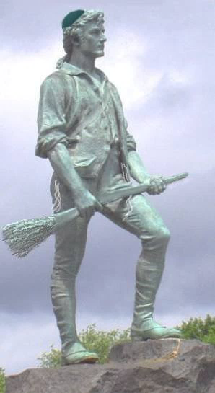
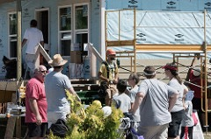
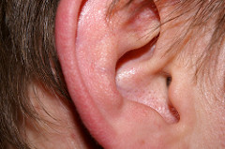
Brotherhood of Temple Israel
2022-2023 Calendar of Events
Jewish Routes Series
Join us for this year’s Jewish Routes discussion series, “Rabbi Fineberg Ruins ______” and together we’ll bust commonly misunderstood myths about Judaism and look at classic Jewish stories and themes through a new lens. Topics will include “Rabbi Fineberg Ruins Wine”, “Rabbi Fineberg Ruins a Classic Jewish Story”, and “Rabbi Fineberg Ruins the Holidays”.” Geared towards learners of all backgrounds – as long as you’re keen to learn with a critical eye, open mind, and generous heart.
Mitzvah Men!
Help us build the Temple Sukkah on Sunday, Sept. 18! Breakfast, ladders, power tools – what could be more fun than that?
A few other great ways to perform Tikkun Olam with the Brotherhood:
Holiday Meals on Wheels
Habitat for Humanity Builds
Shelter Spring Cleanups
Family Table Support
…and more!
Stay tuned for more information!
BOD Meetings (Sun, 10am unless noted)
Aug. 28 | Sep. 25 | Oct. 23
Nov. 20 | Dec. 18 | Jan. 22
Feb. 19 | Mar. 19 | Apr. 23
May 28 | Jun. 25
Nov. 6
Dec. 11
Jan. 29
Feb. 12
Mar. 26
May 7
Hearing Men’s Voices
Our award-winning lay-led discussion series continues with a new theme this year – TO BE DETERMINED! Save the dates below and stay tuned for more information for the topic and themes for each evening’s discussion.
Thursday, Nov. 17, 7:45pm
Tuesday, Dec. 13, 7:45pm
Tuesday, Jan. 24, 7:45pm
Thursday, Feb. 16, 7:45pm
Thursday, Mar. 23, 7:45pm
Tuesday, Apr. 25, 7:45pm
Thursday May 11 (make up date)
Main Events
Oct. 12 Burgers & Beer in the Hut With Sisterhood
Oct. 25 Paid Up Supper Speaker to be Announced
Nov. 6 FJMC Keeper of the Flame Honoring Sonny Michelson
Jan. 7-8 Brotherhood Weekend
Jan. 7 Special Concert!
Feb. 4 Lift Your Spirits
Feb. 12 World-Wide Wrap &
Big Game Party
May 7 Man of the Year
Honoree to be Announced
July 31 Golf Tournament
Speaker “Breakfasts”
Speakers and dates to be announced
Stay tuned for list of speakers!
Other Fun Stuff
STAY TUNED & HELP US WITH PLANNING!

Slide 2
Brotherhood of Temple Israel
2022-2023 Calendar of Events
Jewish Routes Series
Join us for this year’s Jewish Routes discussion series, “Rabbi Fineberg Ruins ______” and together we’ll bust commonly misunderstood myths about Judaism and look at classic Jewish stories and themes through a new lens. Topics will include “Rabbi Fineberg Ruins Wine”, “Rabbi Fineberg Ruins a Classic Jewish Story”, and “Rabbi Fineberg Ruins the Holidays”.” Geared towards learners of all backgrounds – as long as you’re keen to learn with a critical eye, open mind, and generous heart.
Mitzvah Men!
Help us build the Temple Sukkah on Sunday, Sept. 18! Breakfast, ladders, power tools – what could be more fun than that?
A few other great ways to perform Tikkun Olam with the Brotherhood:
Holiday Meals on Wheels
Habitat for Humanity Builds
Shelter Spring Cleanups
Family Table Support
…and more!
Stay tuned for more information!
BOD Meetings (Sun, 10am unless noted)
Aug. 28 | Sep. 25 | Oct. 23
Nov. 20 | Dec. 18 | Jan. 22
Feb. 19 | Mar. 19 | Apr. 23
May 28 | Jun. 25
Nov. 6
Dec. 11
Jan. 29
Feb. 12
Mar. 26
May 7
Hearing Men’s Voices
Our award-winning lay-led discussion series continues with a new theme this year – TO BE DETERMINED! Save the dates below and stay tuned for more information for the topic and themes for each evening’s discussion.
Thursday, Nov. 17, 7:45pm
Tuesday, Dec. 13, 7:45pm
Tuesday, Jan. 24, 7:45pm
Thursday, Feb. 16, 7:45pm
Thursday, Mar. 23, 7:45pm
Tuesday, Apr. 25, 7:45pm
Thursday May 11 (make up date)
Main Events
Oct. 12 Burgers & Beer in the Hut With Sisterhood
Oct. 25 Paid Up Supper Speaker to be Announced
Nov. 6 FJMC Keeper of the Flame Honoring Sonny Michelson
Jan. 7-8 Brotherhood Weekend
Jan. 7 Special Concert!
Feb. 4 Lift Your Spirits
Feb. 12 World-Wide Wrap &
Big Game Party
May 7 Man of the Year
Honoree to be Announced
July 31 Golf Tournament
Speaker “Breakfasts”
Speakers and dates to be announced
Stay tuned for list of speakers!
Other Fun Stuff
STAY TUNED & HELP US WITH PLANNING!

